Slide 1
MEDICAL TERMINOLOGIES -5

Slide 2
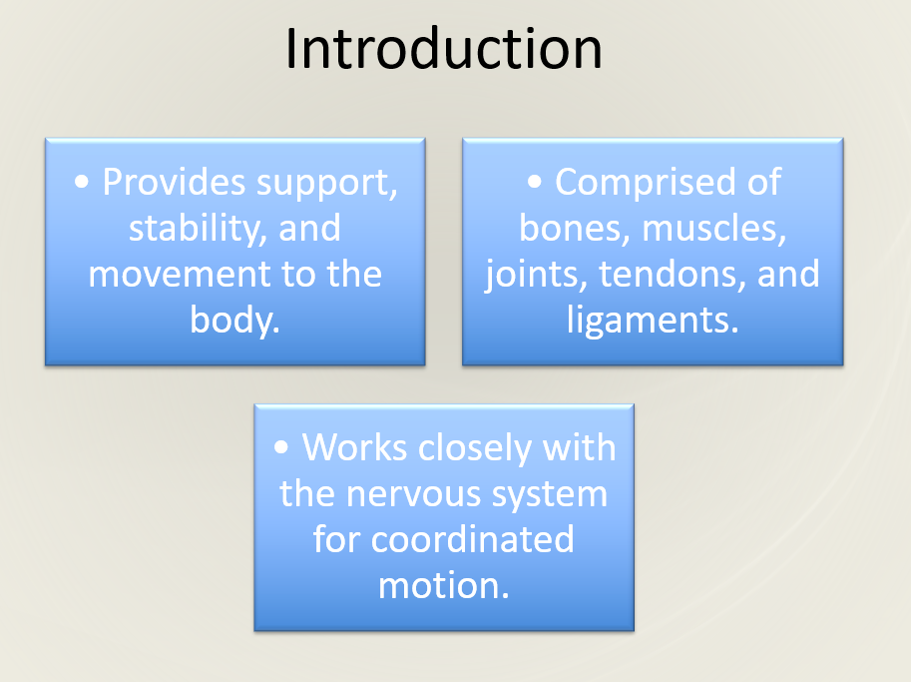

Slide 3
COMPONENTS
1. Skeletal System – 206 bones forming framework.
2. Muscular System – 600+ muscles enabling movement.
3. Joints & Connective Tissues – ligaments, tendons, cartilage.

Slide 4
FUNCTIONS
• Support – Maintains body shape & posture.
• Movement – Skeletal muscles act on bones.
• Protection – Organs shielded by bones.
• Mineral storage – Calcium & phosphorus.
• Blood formation – Bone marrow produces blood cells.

Slide 5
BONE STR.
• Compact bone – Dense outer layer.
• Spongy bone – Contains red marrow.
• Periosteum – Outer covering rich in nerves & blood vessels.

Slide 6
MUSCLE TYPES
• Skeletal – Voluntary, attached to bones.
• Smooth – Involuntary, found in internal organs.
• Cardiac – Involuntary, found in the heart.

Slide 7
JOINTS
• Fibrous joints – Immovable (e.g., skull).
• Cartilaginous joints – Slightly movable (e.g., spine).
• Synovial joints – Freely movable (e.g., knee, shoulder).

Slide 8
NEUROMUSCULAR COORINATION
• Motor neurons stimulate muscle fibers → contraction.
• Proprioceptors provide position sense.
• CNS integrates signals for smooth movement.

Slide 9
Common Disorders
• Osteoporosis – Bone thinning.
• Arthritis – Joint inflammation.
• Muscular dystrophy – Muscle degeneration.
• Fractures & sprains – Trauma-related.

